Slide 1
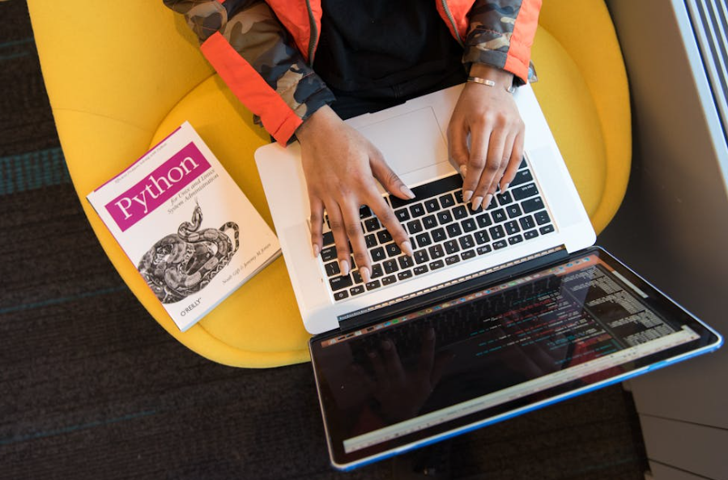
Technology-enhanced Learning
Zhen Pan(231AHG002)

Slide 2

Content
Preparations
1
3
Do
Absorb
2
4
Connect

Slide 3
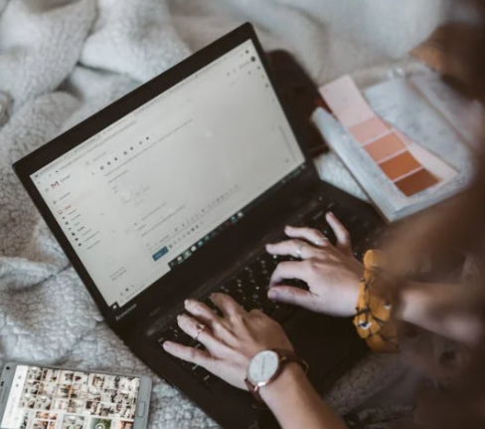
Diagnostic test
01
02
03
04
Facility
Programming Environment
Demand
Practice
Internet Access
ChatGpt
Gmail
Pycharm &
VS code & JupterNotebook
Time Efficiency
Absorb, do and Connect

Slide 4
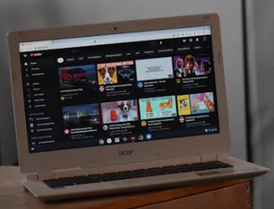
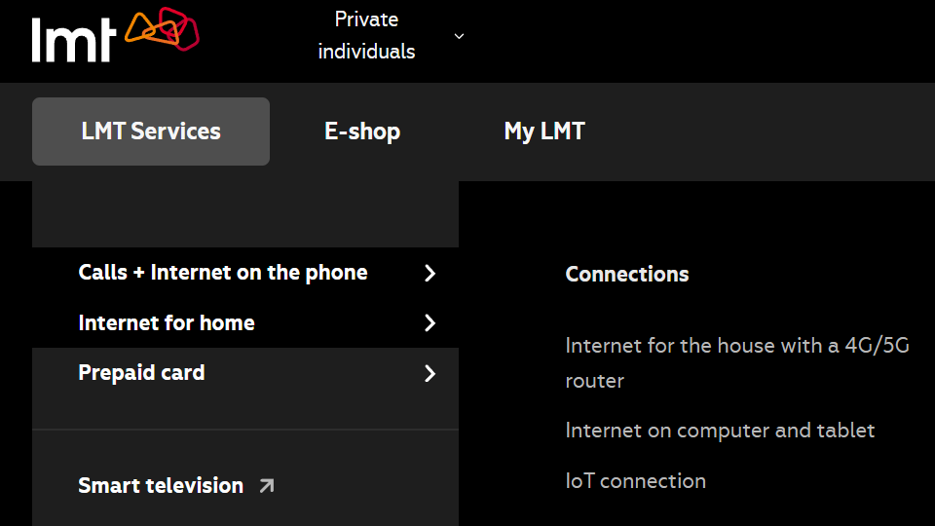
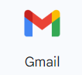


Let’s Get Fully Equipped
Gmail
VS Code
ChatGPT
https://www.youtube.com/watch?v=LWaqSBTfrjc
https://www.youtube.com/watch?v=GZbeL5AcTgw
https://www.youtube.com/watch?v=HMj3bNhVQwg

Slide 5


Absorb
Are you tired of sending repeated daily reports day after day?

Slide 6
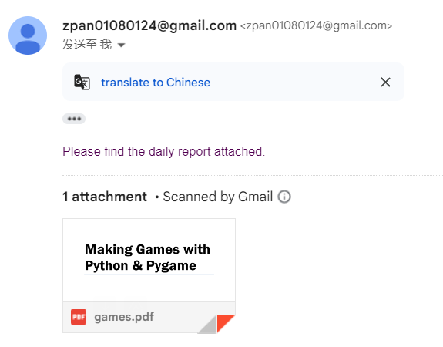
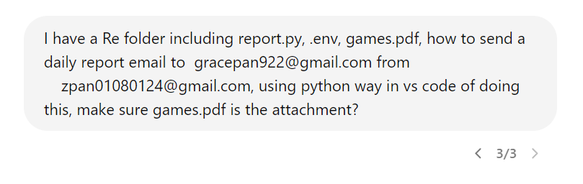
Theoretical Input
Demand | What do I want to do?
Communication | Make prerequisites satisfied
Debugging | Step by Step queries and guidance
Demand | Sending daily reports using python
Communication | From General to Specific
Debugging | Patience and Repetition

Slide 7
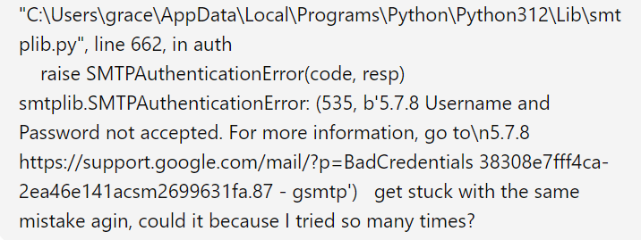
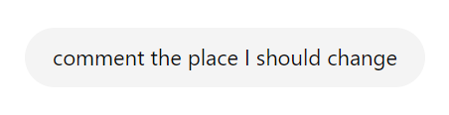
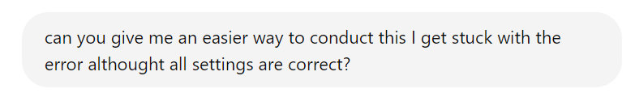
Communication
Pip Install
01
01
Local & global Environment
Make adjustments
02
02
Get to know where to adjust
03
03
Simplify
The simplest solution is often the best

Slide 8
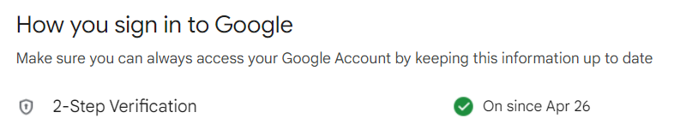
Debugging
2-Step Verification
Step1

Slide 9
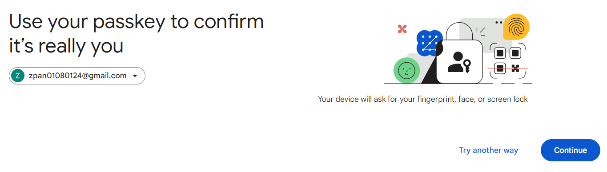
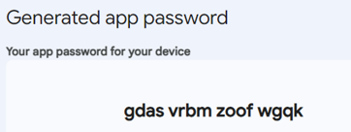
Debugging
App Password Generated
https://support.google.com/mail/thread/205453566?hl=en&sjid=12536434956502427800-EU
Step2

Slide 10
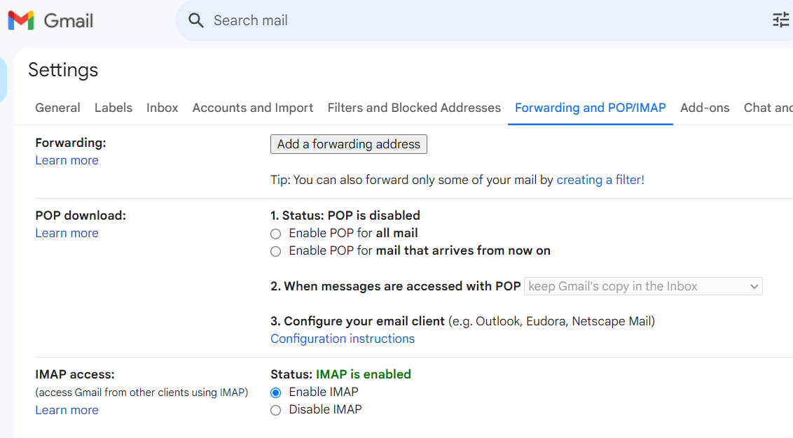
Debugging
Enable IMAP
Step3

Slide 11
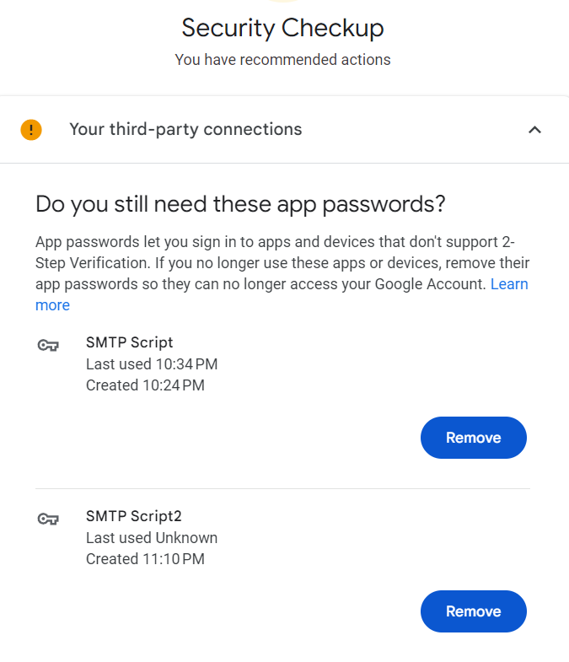
Debugging
Password Removal
Step4

Slide 12
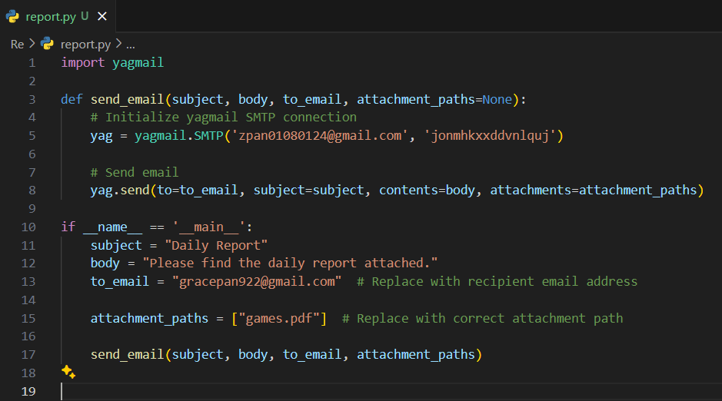
Simplified Code
to_email
Import library
gracepan922@gmail.com
sender & password
attachment
same directory

Slide 13
Formative & Informative Test
 | Prerequisites for the task? | Library to pip install? | Security Settings?
Theory backup?
What have you learnt?
Any question?
???

Slide 14

Do
Why not have a trial?

Slide 15
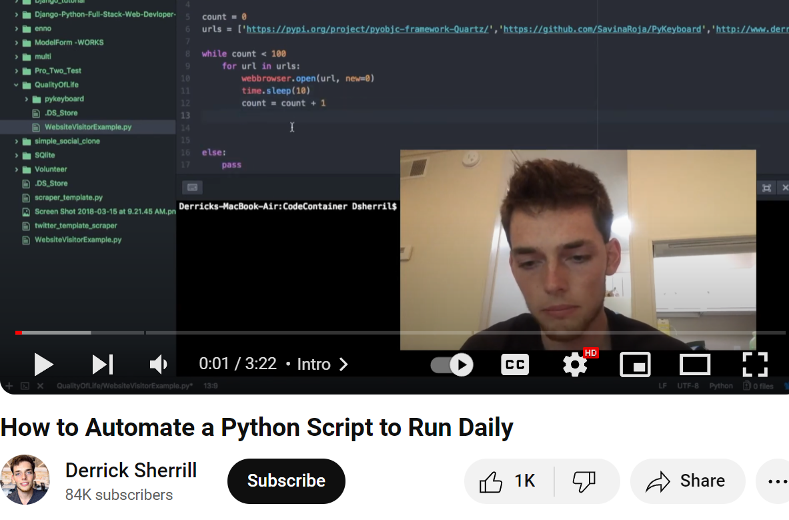
Do
My github walk-through docs
https://github.com/Grace128pan/pythonPrograms
Automate a Python script to run daily
Derrick Sherrill
https://www.youtube.com/watch?v=0fQjA8w1woQ

Slide 16

Connect
Can we empower ourselves?

Slide 17

Summative Test
Imitation
Creation
Email
AI
Theory
Practice
Demand
Communication
Debugging
Send daily email via python
How to debug
Spreading
Do the same
Apply the logic
Spread the idea

Slide 18
Additional Resources
My Github:
https://github.com/Grace128pan/pythonPrograms
ChatGpt Interactions:
https://chatgpt.com/c/53eaf5f5-665b-4352-8634-8cf981889f97
Youtube:
https://www.youtube.com/watch?v=0fQjA8w1woQ
Python Tutorials:
https://docs.python.org/3/tutorial/index.html
Python Books:
https://github.com/pamoroso/free-python-books?tab=readme-ov-file

